Slide 1
Project Title
Windows Log Classifier based on
Naïve-Bayesian Algorithm
-Rajeev Sareen

Slide 2
Abstract
Logging is mechanism to ensure compliance with regulations and to detect abnormalities, security breaches, and privacy violations; however, logging too many events causes overwhelming use of system resources and impacts performance. Consequently, a classification of events is used to prioritize events and configure the log system. Rules can be applied according to this classification to make decisions about events to be archived and types of actions invoked by events. Current classification methodologies are fixed to specific types of incident occurrences and applied in terms of system-dependent description.
KEYWORDS: Logging, events, System resources, Log system, Incident.

Slide 3
Problem Statement
Log analysis involves a human expert who defines message patterns and responses to occurrences. Tools can be used to graphically visualize log data to help in the analysis but detecting message patterns may focus on frequency of occurrences.

Slide 4
Objectives
To develop an application that produces a logging scheme to monitor critical & malicious events specifically for windows operating system by using Naïve Bayes Algorithm.

Slide 5
Introduction
An event log is an ordered sequence of occurrences containing evidence of the execution of a “process” by users, systems, or other entities, including logs about the following:
Application events
Security-related events
System events
Log entries are produced by the activities in network devices, operating systems, applications, hardware and software-based firewalls, Web servers, authentication servers, management information system servers, Web portals, database, query and index servers, mail servers, and Web mail servers.
In our context, the usage data is windows log data, which maintains the information regarding the user interaction with windows operating system using different applications.

Slide 6
Naïve Bayes Classifier
Naïve Bayes Classifiers are a family of simple probabilistic classifiers based on applying Bayes’ theorem with strong(naïve) independence in assumptions between the features.
Bayes theorem plays a critical role in probabilistic learning and classification.
Uses prior probability of each category given no information about an item.
Categorization produces a posterior probability distribution over the possible categories given a description of an item.
It is fast and as compared to other algorithms, it is easy to compute.

Slide 7
Bayes Theorem
Given a hypothesis h and data D which bears on the hypothesis:
P(h): independent probability of h: prior probability
P(D): independent probability of D: evidence
P(D|h): conditional probability of D given h: likelihood
P(h|D): conditional probability of h given D: posterior probability

Slide 8
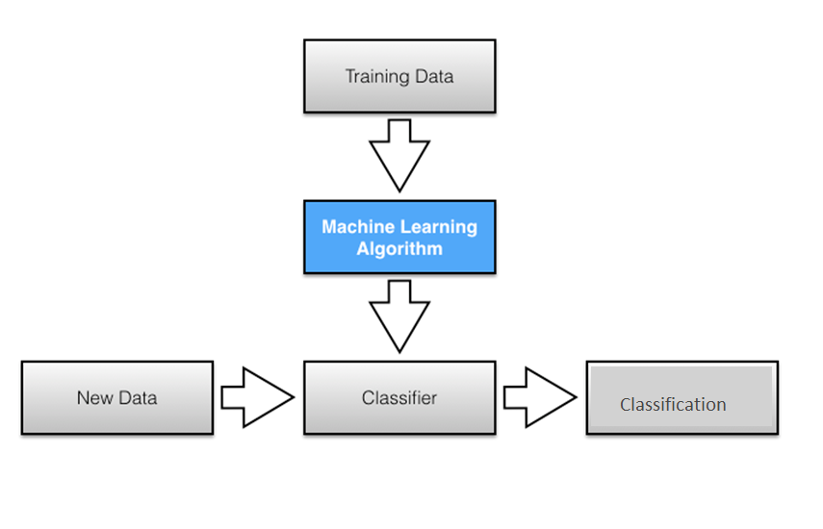
Fig. 1: Naïve Bayes classifier working

Slide 9
System Requirements
Software:
Programming Language: Java
IDE: Eclipse
Operating System: Windows 7 & above
Hardware:
Computer with minimum 512MB RAM, 128GB Hard Drive

Slide 10
Literature Review
Classification of web log data using Naïve Bayesian classification to identify interested users from them was proposed in two phases. In the first phase the web log data is preprocessed, to extract the interested data and then to proceed with the extracted data. The second phase consists of segregating the data using Naive Bayesian Classification. [1]
Association for advancement of Artificial Intelligence researched on the problem of classifying text documents across different distributions. In this work, the identical-distribution assumption on training and test data is relaxed, and a novel transfer learning version of the Naive Bayes classifiers is proposed, allowing the training and test data distributions to be different. This new algorithm is called Naive Bayes Transfer Classifier. [2]

Slide 11
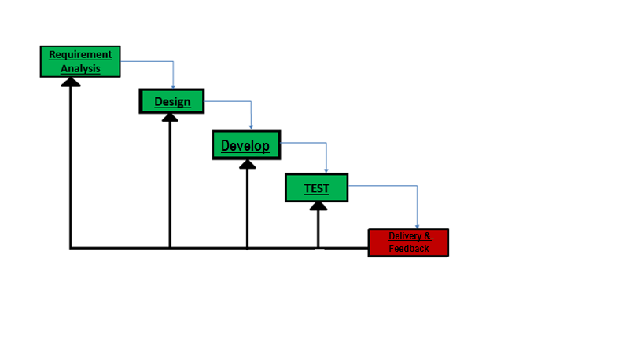
Methodology
Fig. 2.: Iterative Waterfall Model^{[3]}

Slide 12
Methodology
Divided into the following phases:
Requirement Analysis - All possible requirements of the project for development was captured in this phase and documented.
Design - The requirement specifications from first phase was studied in this phase and system design was prepared. System design helps in defining overall system architecture.
Development - Training the log classifier using training data and then, the windows logs were captured; a small unit of program was developed. Each unit after development was tested for its functionality, which is referred to as unit testing.
Test - QA (Quality Assurance) testing was performed on the unit developed in the development phase & was integrated into a system after testing.
Delivery and Feedback– The working iteration was integrated into production & then delivered. User feedback will be accepted and will be working it into the requirements of the next iteration.

Slide 13
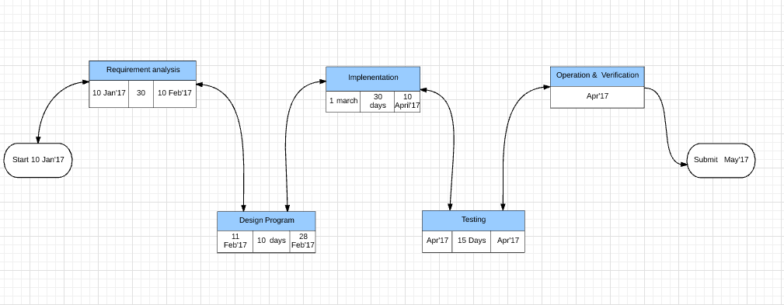
Pert Chart
Fig 3: Pert Chart (Progress)

Slide 14
Flow Chart

Slide 15






Start
Select Cross
Validation Method
Select Input File
Read Input File
Throw Error
No
Success
Message
?
Yes
Divide Data
Is K
No
-
fold
Set into k
Cross
sets
Validation
?
Yes
C
Create Training Set
and Test Set
Calculate Prior Probabilities
for Training Set
B
Calculate Conditional Probabilities
for Feature Values in Test Data
Calculate Posterior
Probabilities for Each Class
A
Fig . 4 : Flowchart for Naive Bayes Classifier

Slide 16






A
Classify
Display Classification
Result
No
Is End of
B
Test Set
?
Yes
Calculate Accuracy
Display Accuracy
No
Yes
Is K
C
Is last set
-
fold Cross
?
Validation
?
Yes
No
End
Fig 4 : Flowchart for Naive Bayes Classifier (continued)

Slide 17
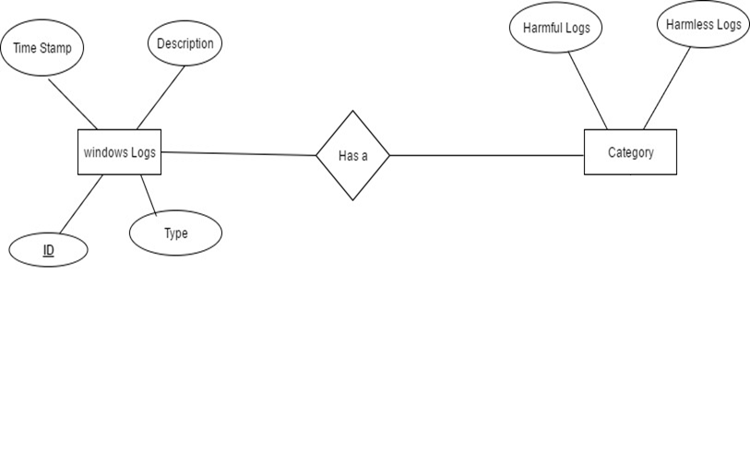
ER Diagram
Fig 5: ER Diagram

Slide 18
UML Diagrams

Slide 19
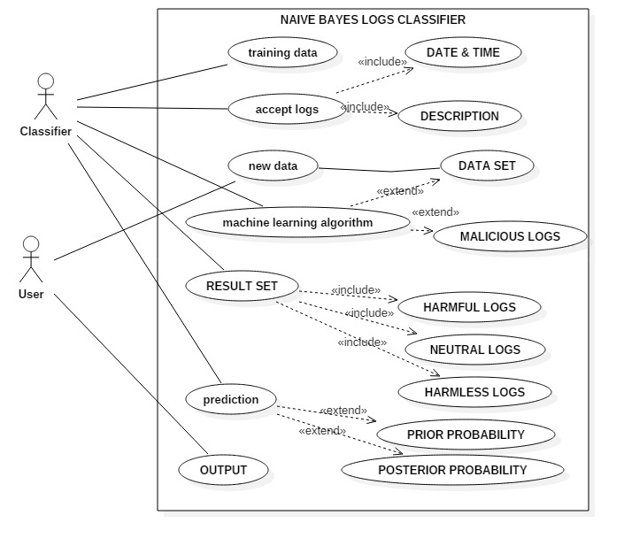
Usecase Diagram
Fig 6: Usecse Diagram

Slide 20
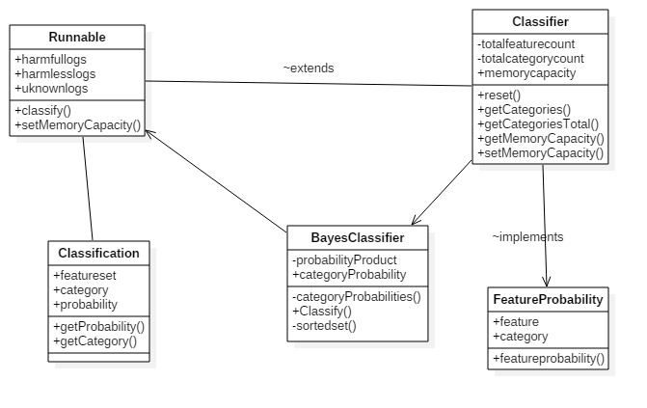
Class Diagram
Fig 7:Class Diagram

Slide 21
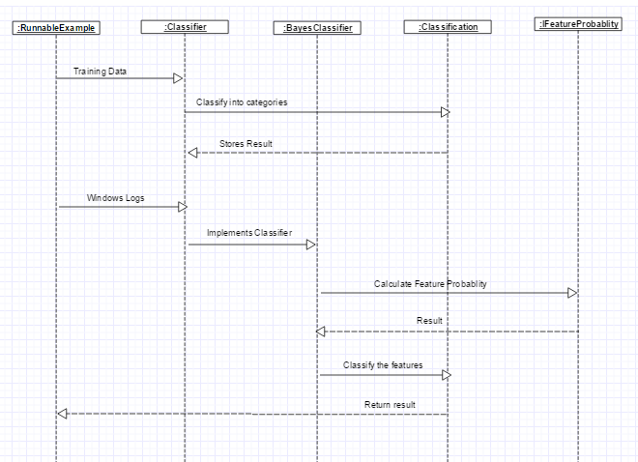
Sequence Diagram
Fig 8: Sequence Diagram

Slide 22
Working Code(Screenshots)

Slide 23
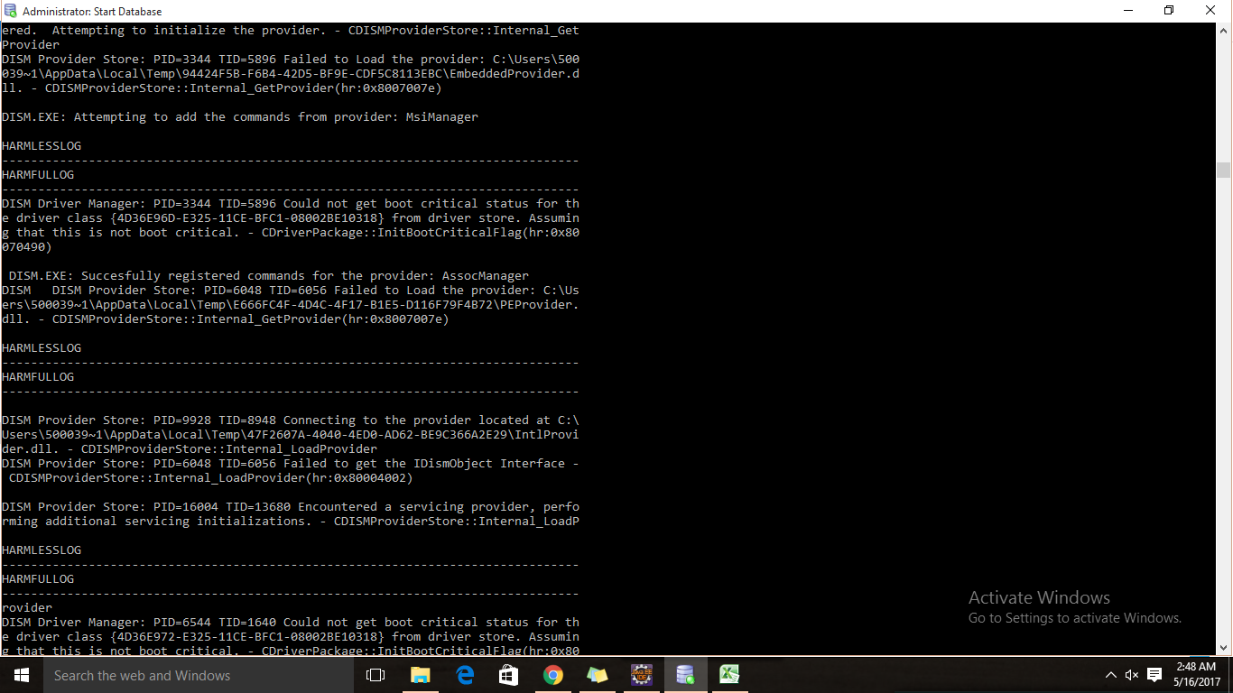
Fig. 9: Database content

Slide 24
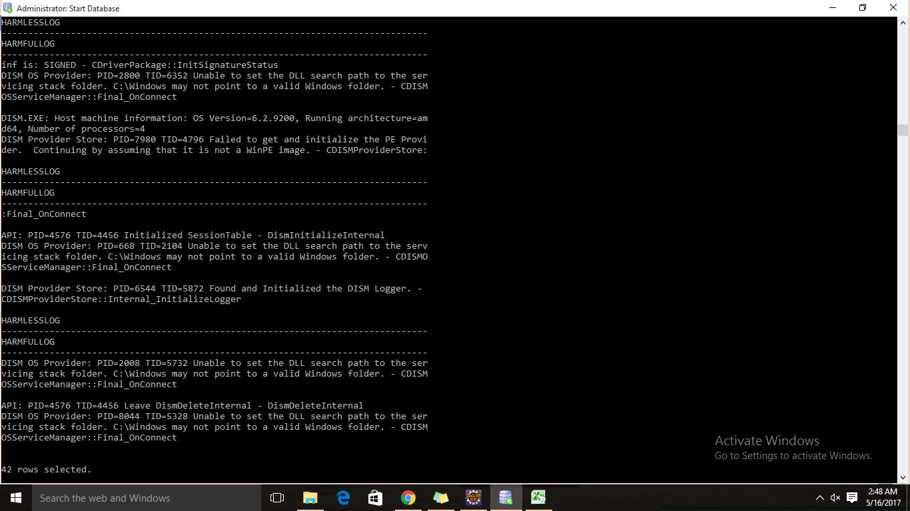
Fig. 10: Training Dataset

Slide 25
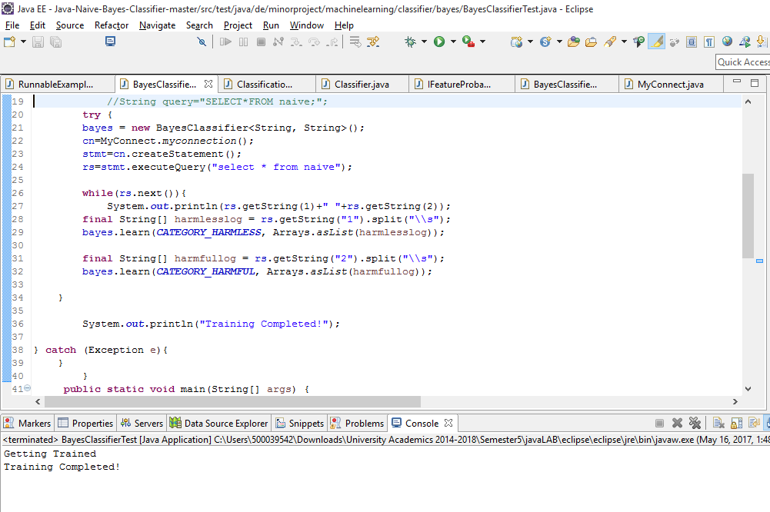
Fig. 11: Training the Classifier

Slide 26
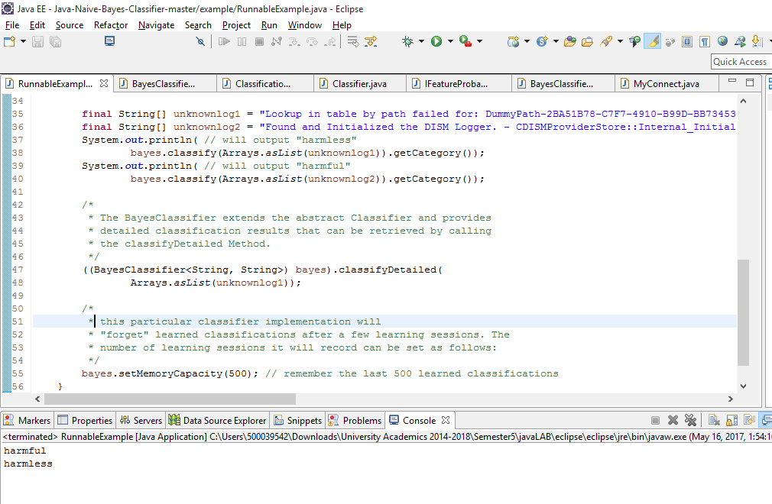
Fig. 12: Classification by Classifier

Slide 27
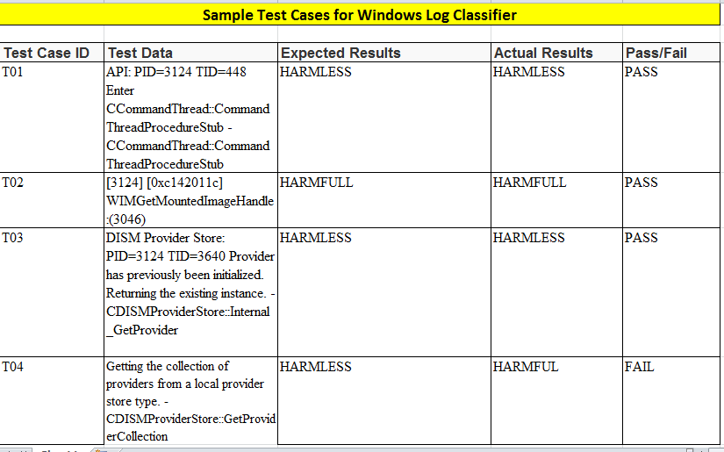
Test Cases and Results
Table 7.1: Test Cases & Results

Slide 28
Conclusion
Towards the end of the project, developers were successfully able to learn about the working of Naïve Bayesian Algorithm for text classification. Developers learned new concepts related to java language, java database connectivity & different type of logs and their criticality in the window’s environment. Because of the limited knowledge and time constraints, developers were only able to build a prototype of the Naïve Bayes Classifier.

Slide 29
Future Scope
The reliability and usability of the application can be improved by usage of automation in the input and output fields.
The classified results can be shown graphically by implementing GUI.
Accuracy of the classifier can be improved by increasing the size of data set and training the classifier.

Slide 30
References
[1] Santra, A. K., & Jayasudha, S. (2012, January). Classification of Web Log Data to Identify Interested Users Using Naïve Bayesian Classification., International Journal of Computer Science Issues, Vol. 9, Issue 1, No 2 (pp. 381-387)
[2] Dai, Wenyuan, Xue, Gui-Rong, Yang, Qiang, & Yu, Yong. (2007). Transferring Naïve Bayes Classifiers for Text Classification. Association for the Advancement of Artificial Intelligence, Machine Learning (pp. 540-545)
[3] Aggarwal, K.K., Singh, Y. (2007). Software Engineering, 3rd Edition, New Age International Publishers

Slide 31
THANK YOU

